Slide 1
Polymeric Prodrugs

Slide 2
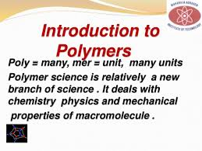

Slide 3
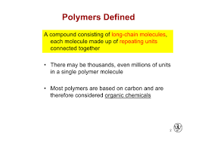

Slide 4
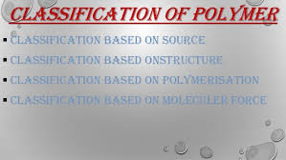

Slide 5
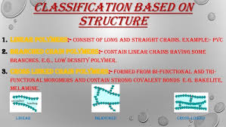

Slide 6
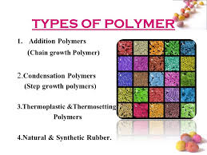

Slide 7
Type of polymers
Based on their origin:
1- Synthetic polymers: it can be widely used because the properties of these molecules can be modified by varying there structures.
The commonly used polymers of this class are:
1) PEG: is a polyether cpd with many applications from industrial manufacturing to medicine.
The structure of PEG is
H-(O-CH2-CH2)n-OH.

Slide 8
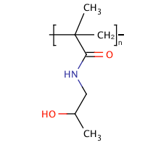
2) Vinyl polymers: a) N-(2-hydroxypropyl)methacrylamide (HPMA)
Poly(HPMA)-drug conjugate preferably accumulates in tumors via the passive-targeting process or the EPR effect).

Slide 9
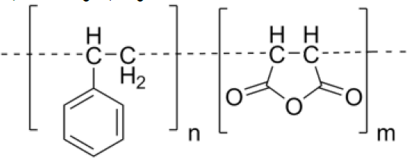
b) Poly(styrene-co-maleic acid/anhydride) (SMA)
Amphiphilic nature of SMA is utilized in stable micelle formation.

Slide 10
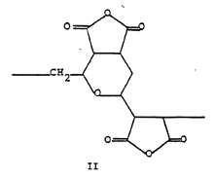
3) Divinylethermaleic anhydride/acid copolymer (DIVEMA)
Divinyl ether (DVE) and maleic anhydride (MA) copolymerize in a 1:2 ratio

Slide 11
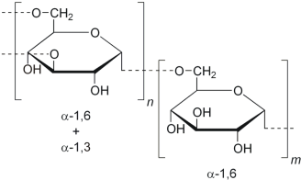
Natural polymers:
1) Dextran:
Dextran is a complex, branched glucan (polysaccharide made of many glucose molecules) composed of chains of varying lengths (from 3 to 2000 kilodaltons)

Slide 12
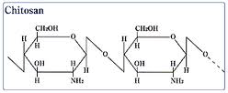
2) Chitosan:
Chitosan is a linear polysaccharide composed of randomly distributed β-(1-4)-linked D-glucosamine (deacetylated unit) and N-acetyl-D-glucosamine (acetylated unit).

Slide 13
Chitosan enhances the transport of polar drugs across epithelial surfaces, and is biocompatible and biodegradable. Oligomeric derivatives (3-6 kDa) are relatively nontoxic and have good gene delivery properties .

Slide 14
3) Proteins: Includes serum albumin which has been used extensively for preparing polymeric prodrugs with anti-viral drugs.
**Albumin gets accumulated within solid tumors and hence is used for drug delivery and tumor targeting. It also increases the stability of attached therapeutic proteins.

Slide 15
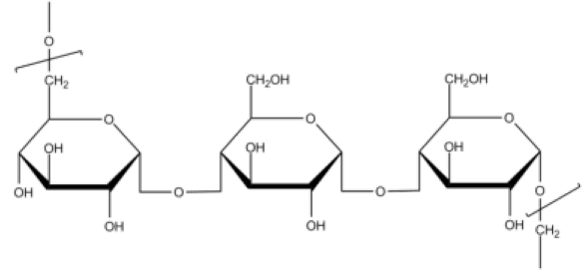
4) Pullulan: is a polysaccharide polymer consisting of maltotriose units,also known as α-1,4-; α-1,6-glucan.

Slide 16
Pseudosynthetic polymers:
1) Synthetic poly(α-amino acids): like poly(L-lysine), poly(L-glutamic acid), poly((N-hydroxyalkyl)glutamines) have functional groups like amine, hydroxyl and carboxyl in their side chains that allows covalent coupling with the drug molecules .
The polymers used mostly in this class include poly(N-(2-hydroxyethyl-L-glutamine))(PHEG) which is non toxic, biocompatible and bio-degradable

Slide 17
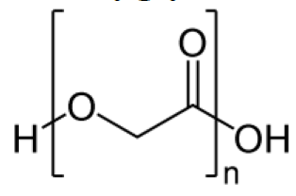
2) Polyglycolide or Polyglycolic acid (PGA)
It is a thermoplastic polymer and the simplest linear, aliphatic polyester

